Slide 1

DriverPass System Analysis
Mosun Solanke
Notes:
[No speaker notes required for this slide.]

Slide 2

System Requirements
Functional Requirements
Customers can schedule driving lessons online
Customers can take practice tests online
Employees can manage appointments
Administrators can manage user accounts
Nonfunctional Requirements
System accessible through the internet
Secure login and password recovery
Cloud-based data storage
Compatible with computers and mobile devices
Notes:
[In your speaker notes, include an explanation of the different requirements you determined for DriverPass’s system. What are the functional requirements you selected to describe? What are the nonfunctional requirements you selected to describe? Be sure to explain how these requirements meet DriverPass’s needs.]
The DriverPass system should offer several essential features for both customers and staff. Customers should have the capability to book lessons, complete practice tests, and monitor their advancement. Employees require resources to handle appointments and customer data. Additionally, the system must ensure security, be accessible online, and function across various devices. These specifications enable DriverPass to deliver convenient and dependable driver training services.

Slide 3
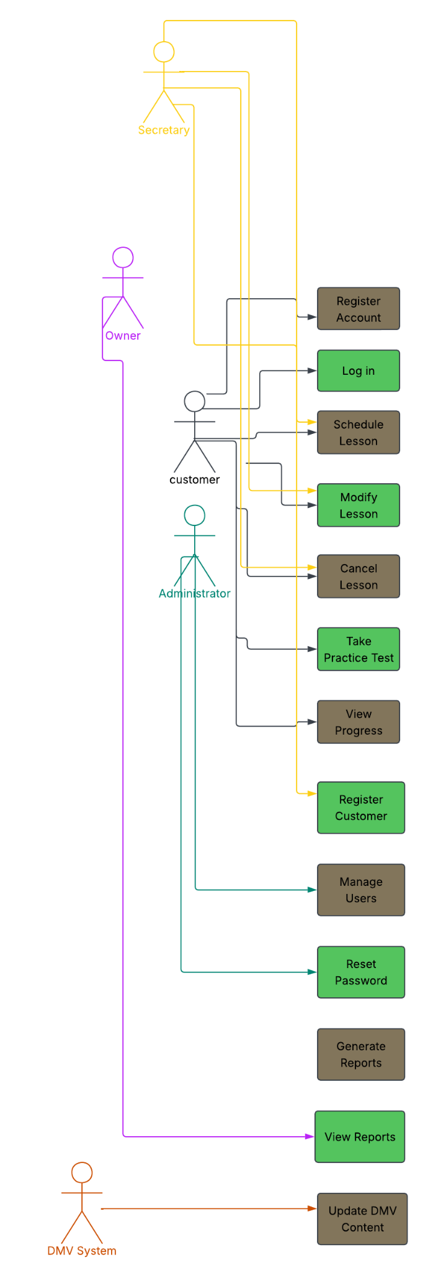
Use Case Diagram
Notes:
[Explain your diagram. Who are the different actors in the system? What are the different use cases? How did you account for DriverPass’s needs in your design? In your explanation, keep your audience in mind. Avoid the use of terms like “actors” and “use cases” in your explanation.]
This diagram demonstrates the various interactions individuals have with the DriverPass system. Clients are able to set up accounts, arrange lessons, complete practice tests, and monitor their development. Office personnel can help clients with booking appointments and handling records. Administrators oversee the system and manage user profiles. The design caters to the requirements of both clients and staff while ensuring that DMV information stays up to date.

Slide 4
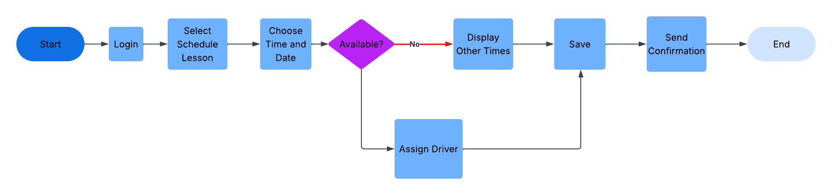
Activity Diagram
Notes:
[Explain your diagram. Which use case are you breaking down? What are the steps for this use case? How did you account for DriverPass’s needs in your design? In your explanation, keep your audience in mind. Avoid the use of technical terms such as “nodes,” “control flows,” and so on.]
This diagram illustrates the process a customer goes through to book a driving lesson. The customer signs in, picks a package, selects a date and time, and then the system verifies availability. If a lesson is open, the reservation is recorded and confirmed. If the chosen time is not available, alternative options are presented. This procedure helps guarantee that appointments are organized effectively and accurately.

Slide 5
Security
Secure user login
Password reset capability
Different access levels for employees
Activity tracking and reporting
Secure storage of customer information
Notes:
[How did you consider security in your design? In your explanation, keep your audience in mind by avoiding the use of technical terms.]
Security is an important part of the DriverPass system. Users must log in before accessing their accounts. Password recovery helps users regain access if they forget their credentials. Different employees have different levels of access based on their responsibilities. Activity tracking records important actions within the system, helping DriverPass monitor changes and maintain accountability. Customer information is stored securely to protect privacy.

Slide 6
System Limitations
Internet connection required for updates
Major package changes require system updates
Depends on DMV information updates
Cloud service outages may affect access
Notes:
[What are the limitations of your design? In your explanation, keep your audience in mind by avoiding the use of technical terms.]
Although the system provides many benefits, there are some limitations. Users need an internet connection to make updates and schedule appointments. Significant changes to lesson packages may require additional development work. The system also relies on updated information from DMV resources to keep training materials current. Access to the system depends on the availability of cloud services and internet connectivity.

